Slide 1
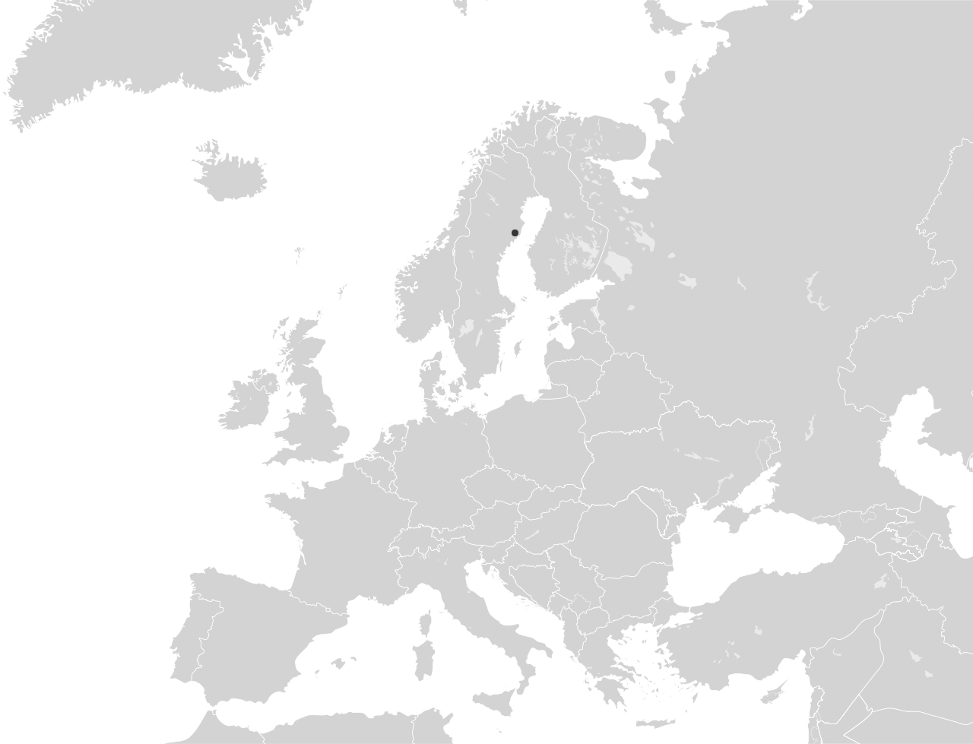
Notes:
Umeå lies in the north of Sweden, latitude 63°
The Gulf Stream provides a good climate, with four seasons
Umeå is located roughly 400 kilometres south of the Polar Circle
Umeå is the province capital of Västerbotten
Hours of sun: 1,782/year
Precipitation: 668 mm/year
Residents: 127,119
Average age: 39
Number of businesses: 14,583
Number of students: 33,979

Slide 2

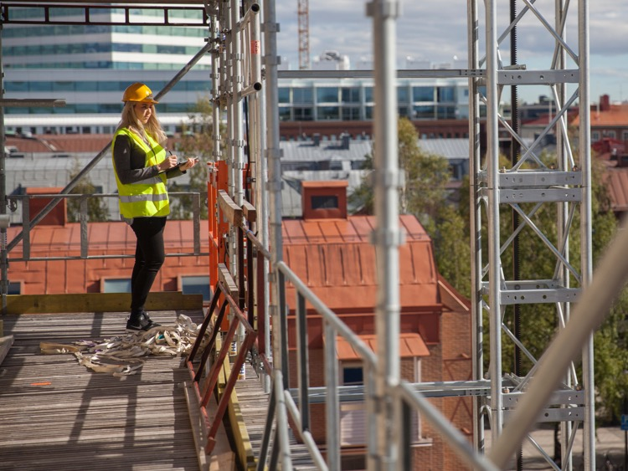
arbetsmarknad
Long-term sustainable progress
The fastest-growing region in northern Sweden
Industry and commerce collaborate with the university
Quality of life is high – equality, sustainability and co-creation are evolving keywords in our continuous development
Notes:
Over the past 50 years Umeå has displayed constant growth, making it the fastest-growing region in northern Sweden.
Umeå is the most populous municipality in northern Sweden.
Situated just a few kilometres from the city centre, Umeå Airport has one of the country’s busiest runways, with over one million travellers passing through the gates every year.
The E4 and E12 highways, as well as the Bothnia Line, pass through Umeå.
Every year 1,000 new jobs are created, and unemployment figures are among the lowest in the country.
Right now several property development projects are under way, with many more planned over the next 10 years.
Umeå is the leading industrial city in northern Sweden, with an ongoing tradition of world-leading innovation in several fields.
Our two universities – Umeå University and the Swedish University of Agricultural Sciences – supply knowledge and competence to industries all over Sweden. Through collaborations between the academic world and industry, new enterprises and innovations are taking shape.
The close interaction between the university and the university hospital stimulates technical development and supports the scientific environment.
The commitment to sustainability issues in Umeå is huge. This has, among other things, resulted in the title 2016 Swedish Earth Hour Capital and made Umeå the 2nd runner up for European Green Capital three years in a row.
Co-creation was the key factor when Umeå applied for – and won – the title European Capital of Culture in 2014. Umeå also took the runner-up spot in its application for European Capital of Innovation 2018.
The city has a long tradition of DIY spirit.
Ensuring equal allocation between men and women with regard to use of training facilities, Umeå has produced some of the country’s most successful female athletes, with top teams in soccer, basketball, floorball and many other sports.
The Social Progress Index measures quality of life based on a number of factors. Northern Sweden has been named the best in the EU.

Slide 3

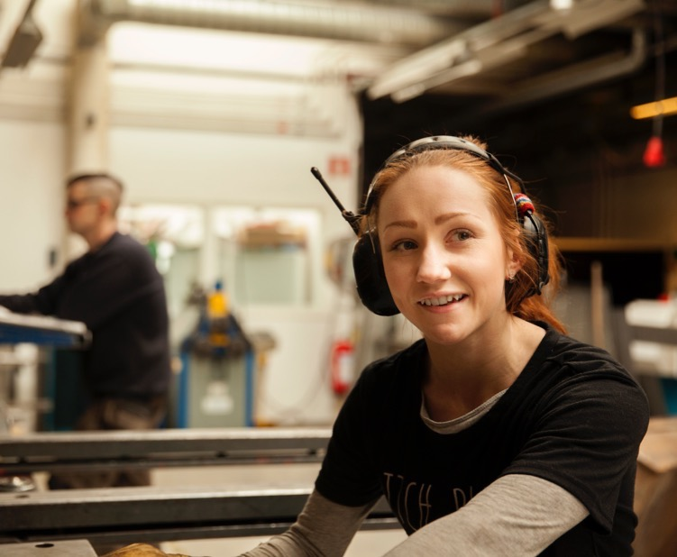
The attractiveness of Umeå is creating the fastest-growing region in northern Sweden
Economic growth generates around 1,000 new jobs every year
Young and highly educated population
An attractive city with young inhabitants generates strong population growth
Boom in construction – fast progress in building industry, housing and infrastructure
Notes:
Over the past 50 years Umeå has displayed constant growth, making it the fastest-growing region in northern Sweden.
Umeå is the most populous municipality in northern Sweden.
Every year 1,000 new jobs are created, and unemployment figures are among the lowest in the country.
Between 2016 and 2018, 2,050 new companies were set up and 3,300 new jobs created in Umeå.
There are many investment projects in progress to meet the increasing demand for facilities for industry and commerce, as well as new housing for the growing population.
Umeå is a highly attractive location due to its dynamic of a well-educated population, a strong innovation environment, an inspiring cultural scene and a safe environment.

Slide 4

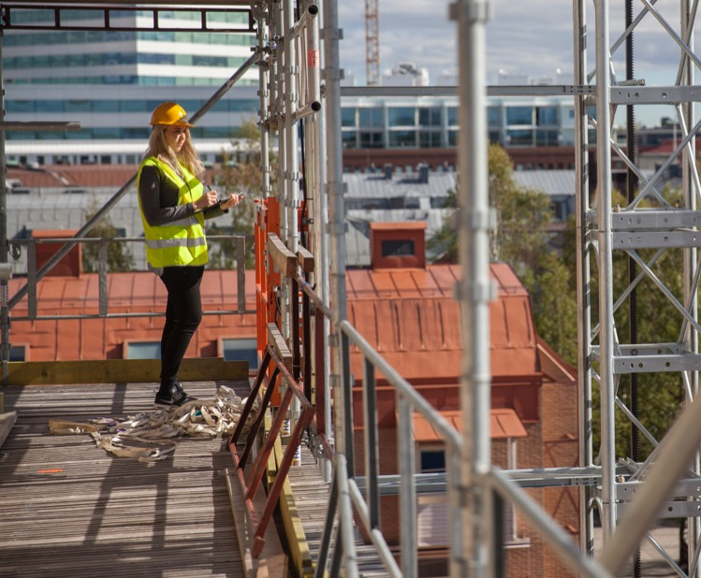
A young and growing population = a dynamic environment
The fastest-growing region in northern Sweden
Strategies in place to maintain fast and sustainable growth
The Umeå Vision: 200,000 inhabitants by 2050
Influx in all categories
Young population
Notes:
Umeå is the fastest-growing region in northern Sweden.
For a long time, Umeå was the fastest-growing city in Europe.
The attraction of Umeå and its young population has generated strong and steady growth over a long period of time.
But we want more!
There are many strategies in place to support strong continuing population growth.
Things are looking good. In 2017 we set a new record, with an increase of 2,188 inhabitants. This rate of growth is continuing, and in 2018 Umeå’s population increased by 2,039.
We are seeing an influx in every category, with people moving in from other municipalities as well as immigration and newborns.

Slide 5
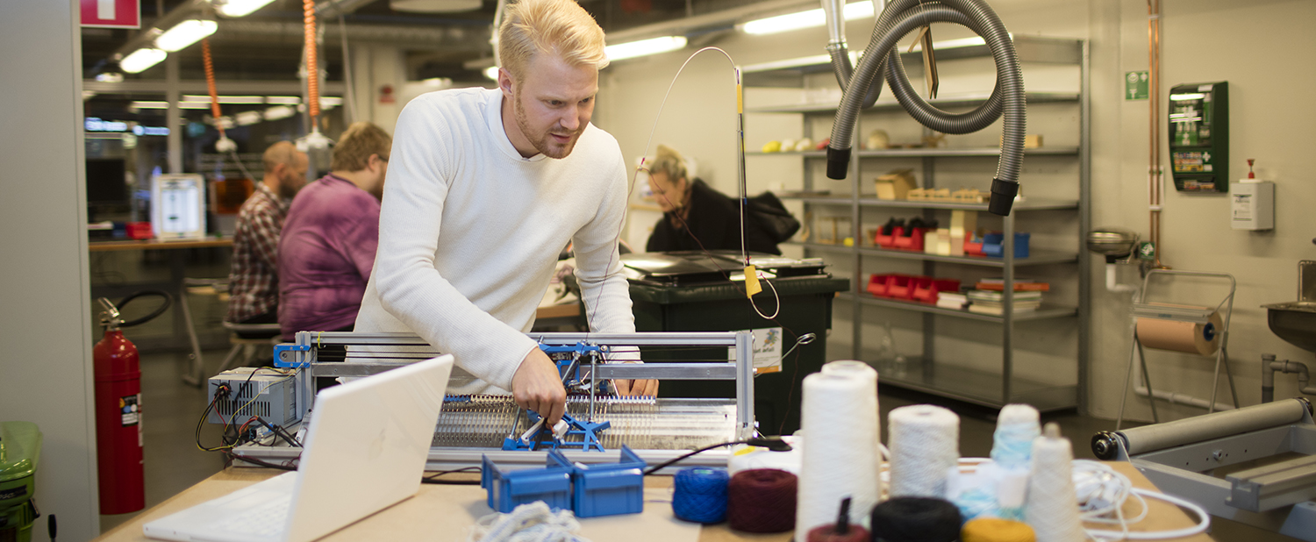
Qualified labour
In Umeå, jobs are evenly divided between industry and the public sector
The variety of educational institutions in the region – specialist high schools, several youth colleges, vocational training and the two universities – ensures plentiful access to a qualified workforce
30 % of all working-age people in Umeå have academic qualifications
Responsive universities can customise programmes to meet market demand
Notes:
Jobs are evenly divided between industry and the public sector, although growth is faster in the latter.
Umeå offers a wide range of educational options. This attracts a lot of young people to the city, in order to attend specialist high schools, a number of youth colleges, vocational or more academic university courses.
Umeå University and the Swedish University of Agricultural Sciences offer a wide range of educational options.
More than 30 % of all working-age people in Umeå have an academic qualification. In other words, there’s great access to and development of a qualified workforce.
The close collaboration between industry, the public sector and the universities enables a quick response to meet changing demands in varying areas.

Slide 6
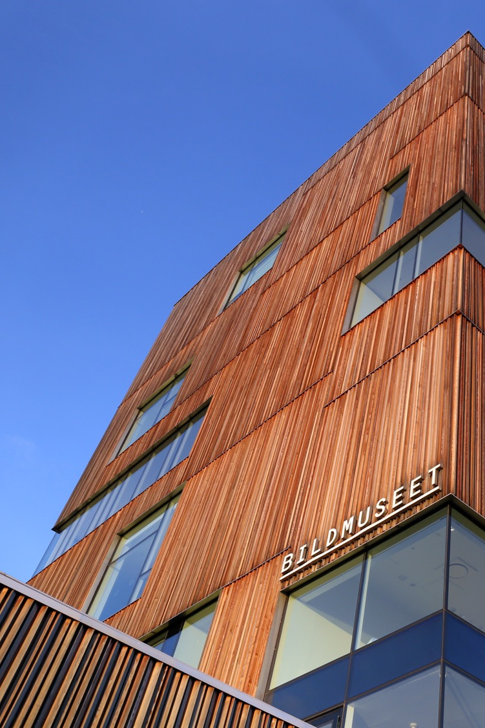
A growing Umeå
– equal and sustainable
Umeå aims to grow vertically – not horizontally
1,337 new homes in 2018; close to the record from 1992
The largest city in Sweden with no socially deprived communities
Equality is an explicit strategy to create security and well-being
Notes:
An attractive Umeå requires sustainable growth strategies.
To create a sustainable city, the development plan relies on sustainable principles. This means Umeå aims to grow vertically in the central areas of the city. This way people will rely less on cars, and instead they can walk or ride a bike between work and home.
1,337 new homes in 2018; close to the record from 1992.
In new districts, and wherever it is possible, wide car lanes will be replaced by streets where pedestrians and cyclists are the focal point.
Growth will also be stimulated in the villages surrounding Umeå. These areas offer an attractive and scenic living environment.
Property development in Umeå is among the strongest in the country.

Slide 7


“In Umeå we’re never better than when we work together”
Business and the public good thrive with mutual trust
The ability to collaborate is one of the scientific explanations for Umeå’s rapid growth
Notes:
In Umeå we’re never better than when we work together. We know that collaboration between industry, academia and the public sector usually pays off for everyone. Certain researchers have tried to explain the fast-paced growth of Umeå by pointing out the high level of “inclusive trust”. Simply put: We trust each other. This makes for effective results, in both business and development of society.
The high level of trust also makes Umeå a safe place – this is reflected in crime statistics. Umeå has the lowest crime rate among all cities of comparable size in Sweden.

Slide 8
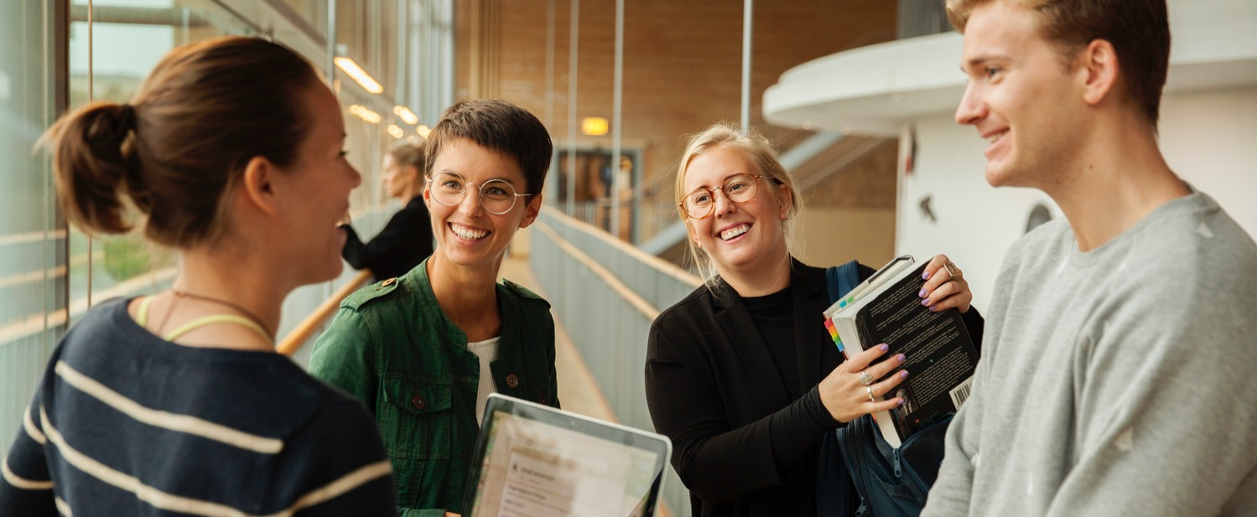
Umeå University and SLU offer a developing environment that strengthens Sweden
Two universities: Umeå University and the Swedish University of Agricultural Sciences
Umeå University is a full-scope university with around 34,000 students and just over 4,000 employees
Strong scientific environment and world-leading programmes
Notes:
Umeå has two universities: Umeå University and the Swedish University of Agricultural Sciences
Each year about 34,000 people receive an education in Umeå.
Umeå University is one of the largest in Sweden, with around 34,000 students and just over 4,000 employees.
Umeå University is a full-scope university with research fields spanning medicine, natural science, engineering science, social science, liberal arts, education science and fine arts.
Many of the 2,000 scholars/lecturers at Umeå University are among the best in their fields, both nationally and internationally. Long-term projects, high quality and the opportunities for a high degree of risk-taking are the foundation of this research.
Many of the university’s research projects attract names of the highest international calibre. One notable example is Emanuelle Charpentier, who is considered a likely candidate for the Nobel Prize in chemistry. Her research team made a discovery that led to the development of a tool – often called “molecular scissors” – enabling editing and alteration of the DNA of organisms.
The research conducted at Umeå Plant Science Centre is considered world-leading.
Umeå Institute of Design is ranked #1 in the world for industrial designers within its field.
Umeå University has four campuses: two located in Umeå, one in neighbouring Skellefteå and one in Örnsköldsvik.
The Umeå campus is situated next to Norrland’s University Hospital. Umeå Arts Campus is located by the Umeå River, incorporating Umeå Institute of Design, Umeå Academy of Fine Arts and the Umeå School of Architecture. On the campus you’ll also find HUMlab-X and Bildmuseet – Umeå University’s museum of contemporary art and visual culture.
Both the prestigious Red Dot Institute and iF (Industrie Forum) rank Umeå Institute of Design at Umeå University as having the best design courses in Europe and the world.
Sliperiet is a creative hub, a research and innovation centre, an event facility and a makerspace.
The Swedish University of Agricultural Sciences has around 350 full-time students and is mainly located at the university campus in Umeå. This is where most of the research takes place, as well as examinations for the Master of Science in Forestry.
There are strong incubators linked to Umeå University, where scientific progress generates businesses.

Slide 9
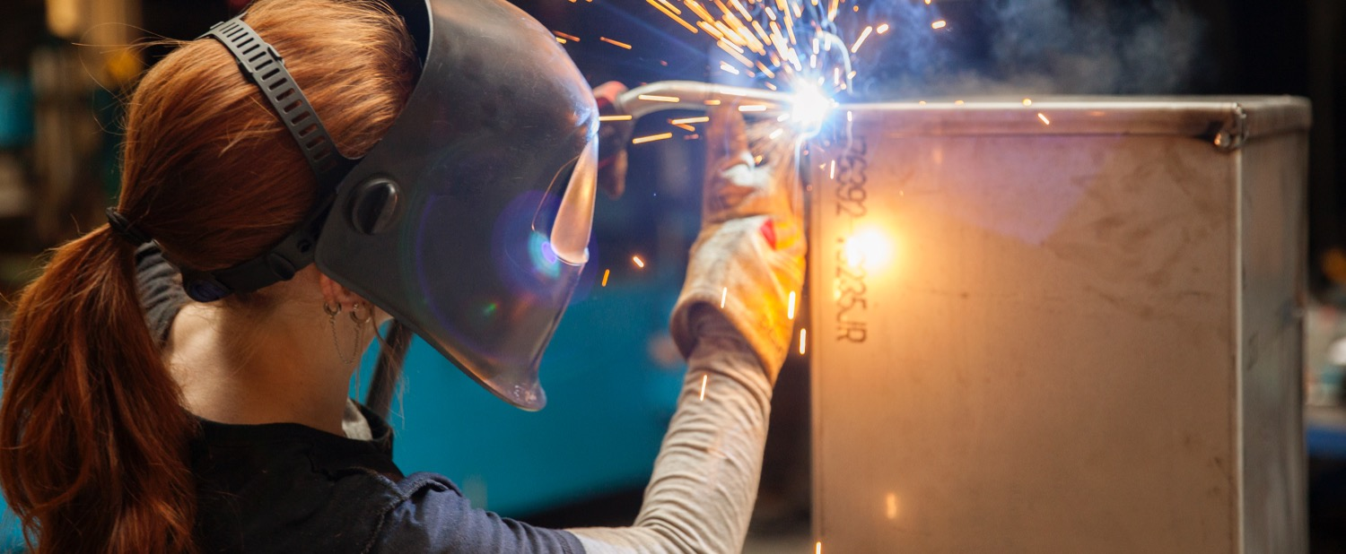
Umeå industries – innovative by tradition
Volvo – large-scale production of truck cabs
Ålö – the world’s largest manufacturer of front-end loaders
Komatsu Forest – world-leading player within the forestry industry
Cytiva Umeå – world leading manufacturer of high-tech instruments and systems for medical research and production of vaccines and biological treatments
Notes:
Umeå is the industrial capital of northern Sweden, and businesses are frequently based on local innovation.
Volvo Trucks, the largest private employer in Umeå, can be traced back locally to 1920. This was when Gösta Nyström, a local furniture maker, designed the first self-sustaining steel truck cab. Volvo, seeing a great competitive edge in this particular safeguard, eventually purchased the factory. The development and expansion of the bodyshop has resulted in Volvo taking the lead in manufacturing truck cabs.
In the 1940s, farmer Karl-Ragnar Åström recognised the need for tools for the farm’s tractor. He founded Ålö AB – now the world’s largest supplier of front loaders.
In the 1960s, Umeå Mekaniska AB was involved in developing machinery for the forestry industry. This operation was to become a world leader under the name Komatsu Forest.
Today, industry in Umeå ranges from Cytiva Umeå – world leading manufacturer of high-tech instruments and systems for medical research – to world-renowned conference-phone brand Konftel.

Slide 10


Mer relaterad bild
A city of early adopters
Early access to fast broadband
Wide-ranging expertise in telecoms, fintech and video/audio
First in Sweden to have city-wide Internet of Things
Sweden’s first test city for 5G
Gaming industry on the rise
Notes:
Umeå has a long-standing tradition of innovation in technology.
Access to a qualified workforce from Umeå University has made for strong growth.
The major national IT consultancy agencies are represented in Umeå, as well as more specialised firms. Technology developed in Umeå can be found in many of the mobile phone innovations sold internationally.
There’s currently a wide range of IT-related ventures in Umeå, with companies focusing on fintech (financial technologies), new media solutions and an exciting gaming cluster.
Broadband in Umeå is said to be among the fastest in the world, but what’s unknown to most is that Umeå has a city-wide network for all online gadgets – a prerequisite for growth in the Internet of Things. In 2019–2022, Umeå will serve as Sweden’s first test city for 5G.
Among the most notable ventures, Google purchased Umeå-based Limes Audio in 2016.
Umeå-based company Coldwood Interactives was awarded the Best Strategy Game prize for its game Unravel at Gamescom, the world’s biggest video game fair. The game Unravel Two received a D.I.C.E. Award in the category Best Family Game of the Year in 2018.

Slide 11
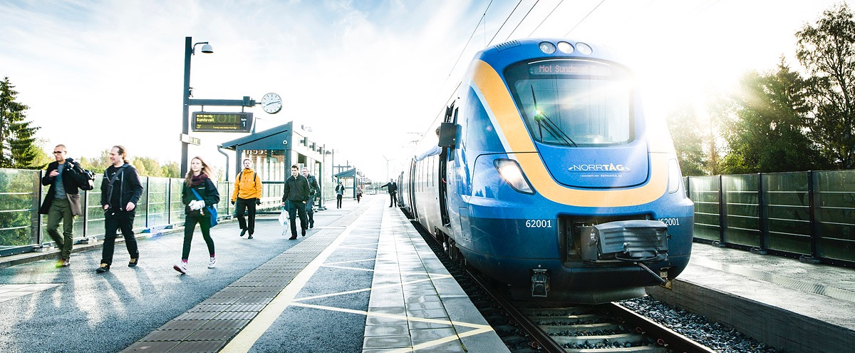
Strategic location in the north
Good infrastructure – regionally, nationally and internationally
Umeå airport is the seventh largest in the country
The Bothnia Line and the North Bothnia Line
Large-scale investments in harbour and logistics
Notes:
Umeå is strategically located in northern Sweden, a fact reflected by the well-developed infrastructure.
Two European highways pass through Umeå, and the airport has many daily departures to major cities.
The Bothnia Line offers efficient freight transport and passenger transport. There are also regular ferry services connecting Umeå to Vaasa and Finland.
Umeå airport is the seventh largest in Sweden. Over one million travellers pass through the gates every year. Seven airlines serve the airport, with direct routes to Helsinki, Stockholm Arlanda and Stockholm Bromma, as well as a large number of charter destinations. Further expansion is planned.
Umeå Harbour is one of the largest in northern Scandinavia, with annual cargo volumes of around 2.3 million tons.
Half the products passing through the harbour are forest-related, including kraftliner, wood supplies and more. The harbour is strategically situated to take advantage of the shortest distance between Sweden and Finland, crossing the northern Bothnian Sea. The harbour is open all year round.
From Umeå, there are daily ferry departures to Vaasa in Finland. A new, modern and more eco-friendly ferry will replace the current vessel in April 2021.
The Bothnia Line efficiently connects Umeå with the rest of Sweden and Europe, providing both passenger and freight transport. A decision was recently made to extend the line to the north, creating the North Bothnia Line.
Nordic Logistic Center is a combined terminal for intermodal distribution of goods transported by rail, road and sea. The facility, located in Umeå, also houses third-party storage units.

Slide 12


Quality of life – with equality,
sustainability and co-creation
The most environmentally conscious citizens in Sweden
European Capital of Culture
Equality in sports
Sweden’s top city for sport in 2018
Social Progress Index #1
Notes:
The commitment to sustainability issues in Umeå is huge. This has, among other things, resulted in the title 2016 Swedish Earth Hour Capital, and made Umeå the 2nd runner up for European Green Capital three years in a row.
Co-creation was the key factor when Umeå applied for – and won – the title European Capital of Culture in 2014. The city has a long tradition of DIY spirit.
Ensuring equal allocation between men and women with regard to use of training facilities, Umeå has produced some of the country’s most successful female athletes, with top teams in soccer, basketball, floorball and many other sports.
After having been runner-up on two occasions, Umeå was named Sweden’s top city for sport in 2018.
The Social Progress Index measures quality of life based on a number of factors. Northern Sweden has been named the best in the EU.

Slide 13
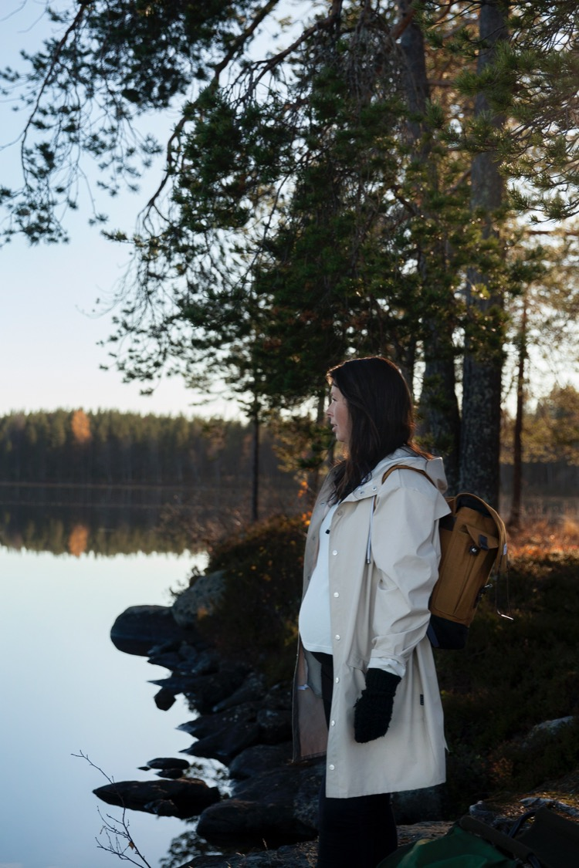
Sustainable progress in
a growing community
Environmental collaboration between municipality, university and industry
2016 Swedish Earth Hour Capital
European Green Capital finalist three years in a row
Notes:
The residents of Umeå are environmentally conscious to a great degree. This drives municipal organisations to work actively on sustainability issues, often in collaboration with the university and local industry.
2016 Earth Hour Capital
An international jury crowned Umeå the 2016 Earth Hour Capital. The jury was impressed by the city’s ability to forcefully pursue its climate strategies, and how several substantial initiatives make it easier for industries and citizens to make sustainable choices.
Green Umeå
The Green Umeå initiative was implemented by the municipality and rallies companies, organisations and individuals with a vision for a greener future in Umeå and the northern region.
European Green Capital
Three-time runner up for European Green Capital, Umeå has set an example in its efforts to be a sustainable city. Umeå has distinguished itself in the following fields:
1. Noise
2. Energy and environmental innovation
3. Sustainable employment

Slide 14
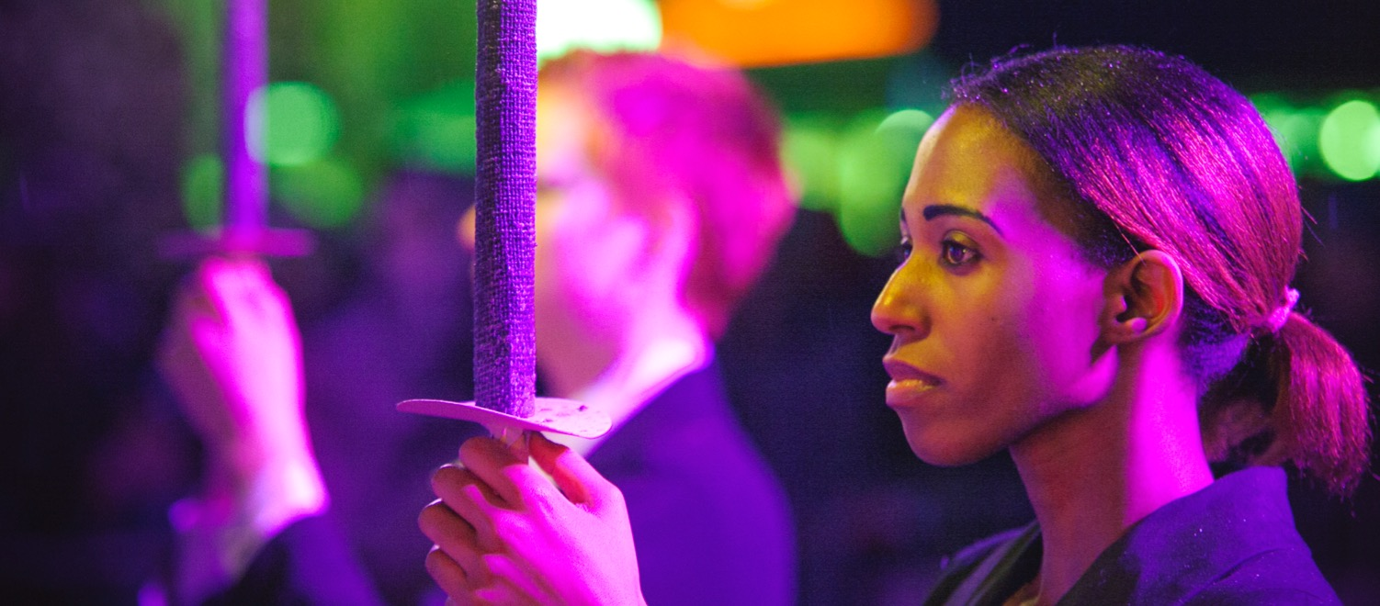
Culture creates compassion
European Capital of Culture 2014
DIY tradition
Versatile music and arts scene
Notes:
Umeå has a very rich cultural scene.
For many decades, Umeå has put more resources into culture than other Swedish cities. We believe this is one of the reasons why so many people choose to come here.
One could argue that the versatility of culture gives people the ability to see the world from different perspectives, making the individual more involved in creating a sustainable community.
We’d like to think this is the case in Umeå. The keywords in Umeå’s application for European Capital of Culture were the art of curiosity, compassion and co-creation. This really sums up what’s so special about Umeå. There’s a long history of commitment, and commitment is important in a democracy.
Being the European Capital of Culture served as a great showcase towards Europe. We’ve utilised this to show that we’re one of the foremost cities in Europe when it comes to culture. Through Umeå2014, cultural exchange with Europe has increased, and it’s given Europe the chance to acquaint itself with the cultural life of Umeå. And we’ve created strong bonds with new European friends.
When it comes to describing the culture of Umeå, it’s tempting to simply list the many museums, the extensive repertoire of NorrlandsOperan, the many dance groups, the art and music scene and the festivals. But we believe everyone can relate to culture, and that culture builds strong communities. That’s why we keep pursuing cultural activities in Umeå.

Slide 15
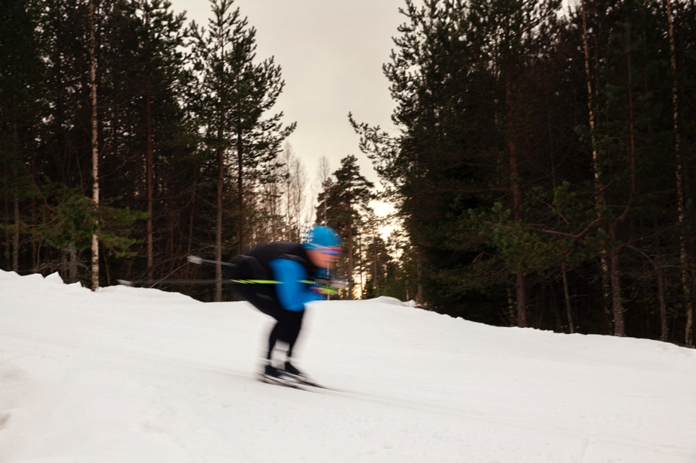
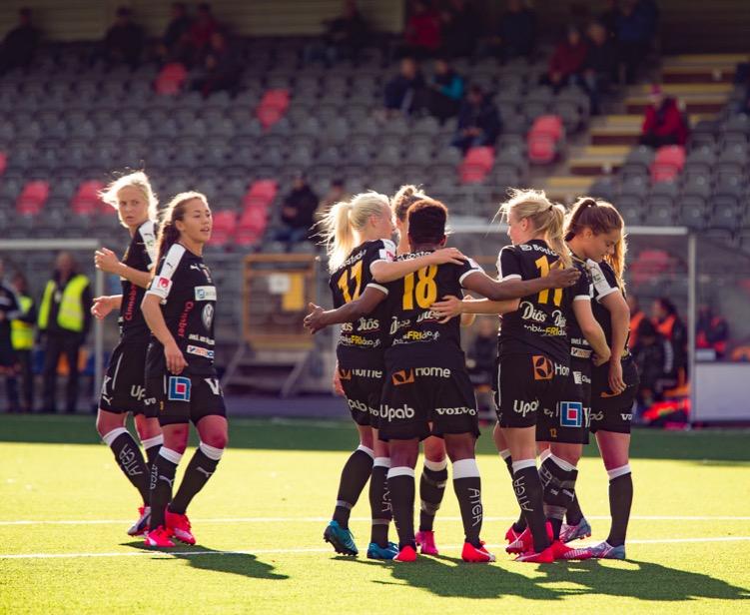
Equality in sports – a winning concept
Umeå – early adopters of equal-use allocation of training facilities between genders
Successful athletes and teams
One of Europe’s largest sports centres – located in Umeå
Notes:
In Umeå there’s always an opportunity to exercise, indoors and outdoors, all year round.
Around the city there’s a wide range of gyms, cross-country tracks, riding schools, skate parks, ski slopes, curling facilities, hockey rinks and much, much more.
There are also beautiful hiking trails, bike paths and opportunities for fishing and various outdoor activities.
Next to the university campus you’ll find IKSU – one of Europe’s largest training facilities. It’s one of Sweden’s busiest buildings, with more than 30,000 visitors a week.
At the beginning of the 21st century Umeå made a groundbreaking decision: equal training time for men and women. This has resulted in some incredibly successful female sports teams, for example:
Umeå IK football
7 Swedish Championship titles
4 Swedish Cup titles
2nd in UEFA Women’s Cup/UEFA Women’s Champions League (2007/2008)
IKSU floorball
6 Swedish Championship titles
6 European Cup titles
Udominate basketball/A3 basketball
4 Swedish Championship silver medals
Umeå University is one of three national schools of sport sciences.
To strengthen the competitive level of Swedish sports and enable high-level athletes to combine sports with academic studies, Sports in Sweden (Riksidrottsförbundet) has worked to create national sports universities that can offer our top athletes customised study programmes combining sports and studies.

Slide 16

Umeå is a progressive role model
A long history of widespread literacy
A tradition of debate and discussion
An important hub in northern Sweden
Absence of a class society
Notes:
Umeå is part of the international context. Every day you’ll find companies, scientists, cultural figures, athletes and others who question the norm, challenge the expected and suggest new solutions.
Umeå produces numerous examples of products, methods and scientific findings at the cutting edge of development.
The hallmarks of a resident of Umeå are a questioning mind, an openness to new ideas and impressions and an idealistic mentality.
Creativity, commitment and openness, as well as entrepreneurship and trust, also define the overall attitude in Umeå. Taking all those factors together makes Umeå a progressive role model. We believe the world needs seminal solutions to its existing challenges.
We believe the world would be a better place if more people shared this attitude.

